Slide 1
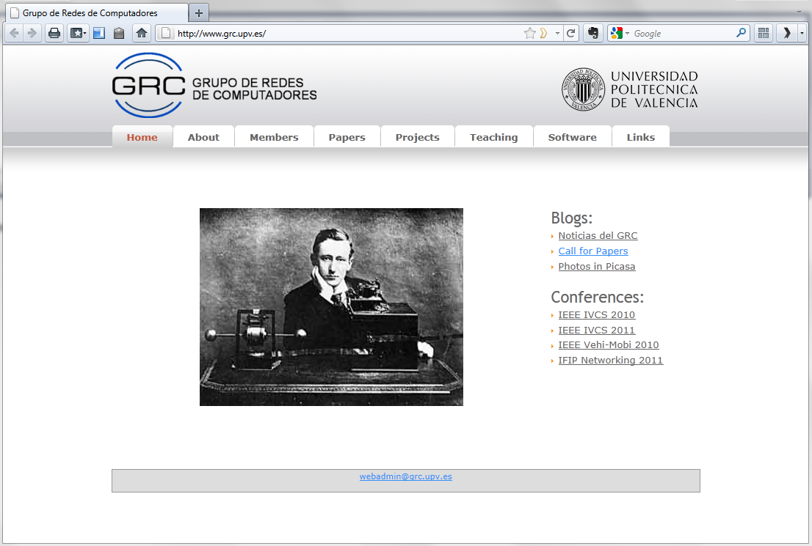
INET framework extensions for TCP
Vegas and TCP Westwood
María Fernandez, Carlos T. Calafate,
Juan-Carlos Cano and Pietro Manzoni
http://www.grc.upv.es/
Computer Networks Group
Department of Computing Engineering,
Technical University of Valencia
SPAIN
1

Slide 2
Outline
Evolution of TCP
TCP in INET 2.0 / OMNeT++
Implementation
Simulation results
Conclusions & Future Work

Slide 3
Evolution of TCP
Initial proposal
RFC 675 (1974)
RFC 793 (1981)
General performance improvements
Wireless-specific solutions
And many more…
Van Jacobson
(1988-90)
I-TCP (1995)
Snoop TCP (1995)
TCP Vegas (1994)
Mobile-TCP (1997)
TCP SACK (1996)
TCP FACK (1996)
WTCP (1999)
Congestion control (1997)
TCP Santa Cruz (2000)
TCP Westwood (2002)
.
.
.
TCP Veno (2003)
Multipath (2011)
.
.
.

Slide 4
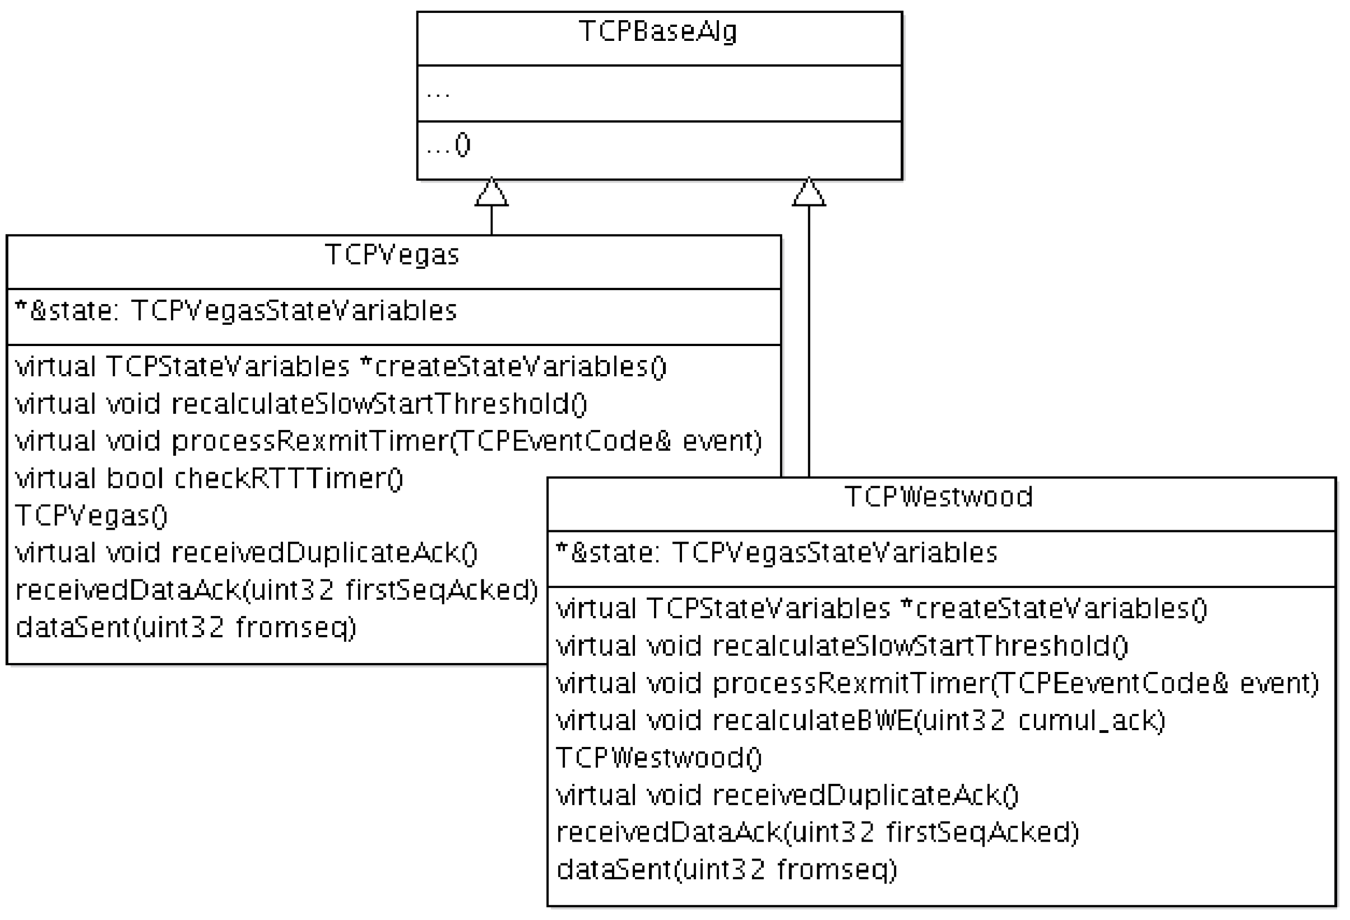
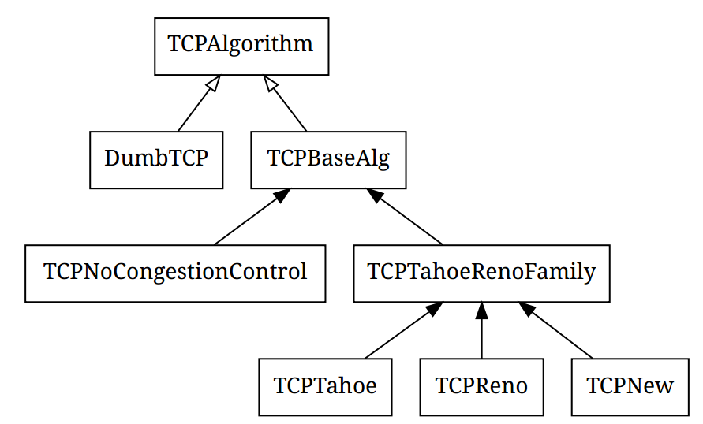
TCP in INET2.0 / OMNeT++
EXISTING…
NEW!!!

Slide 5
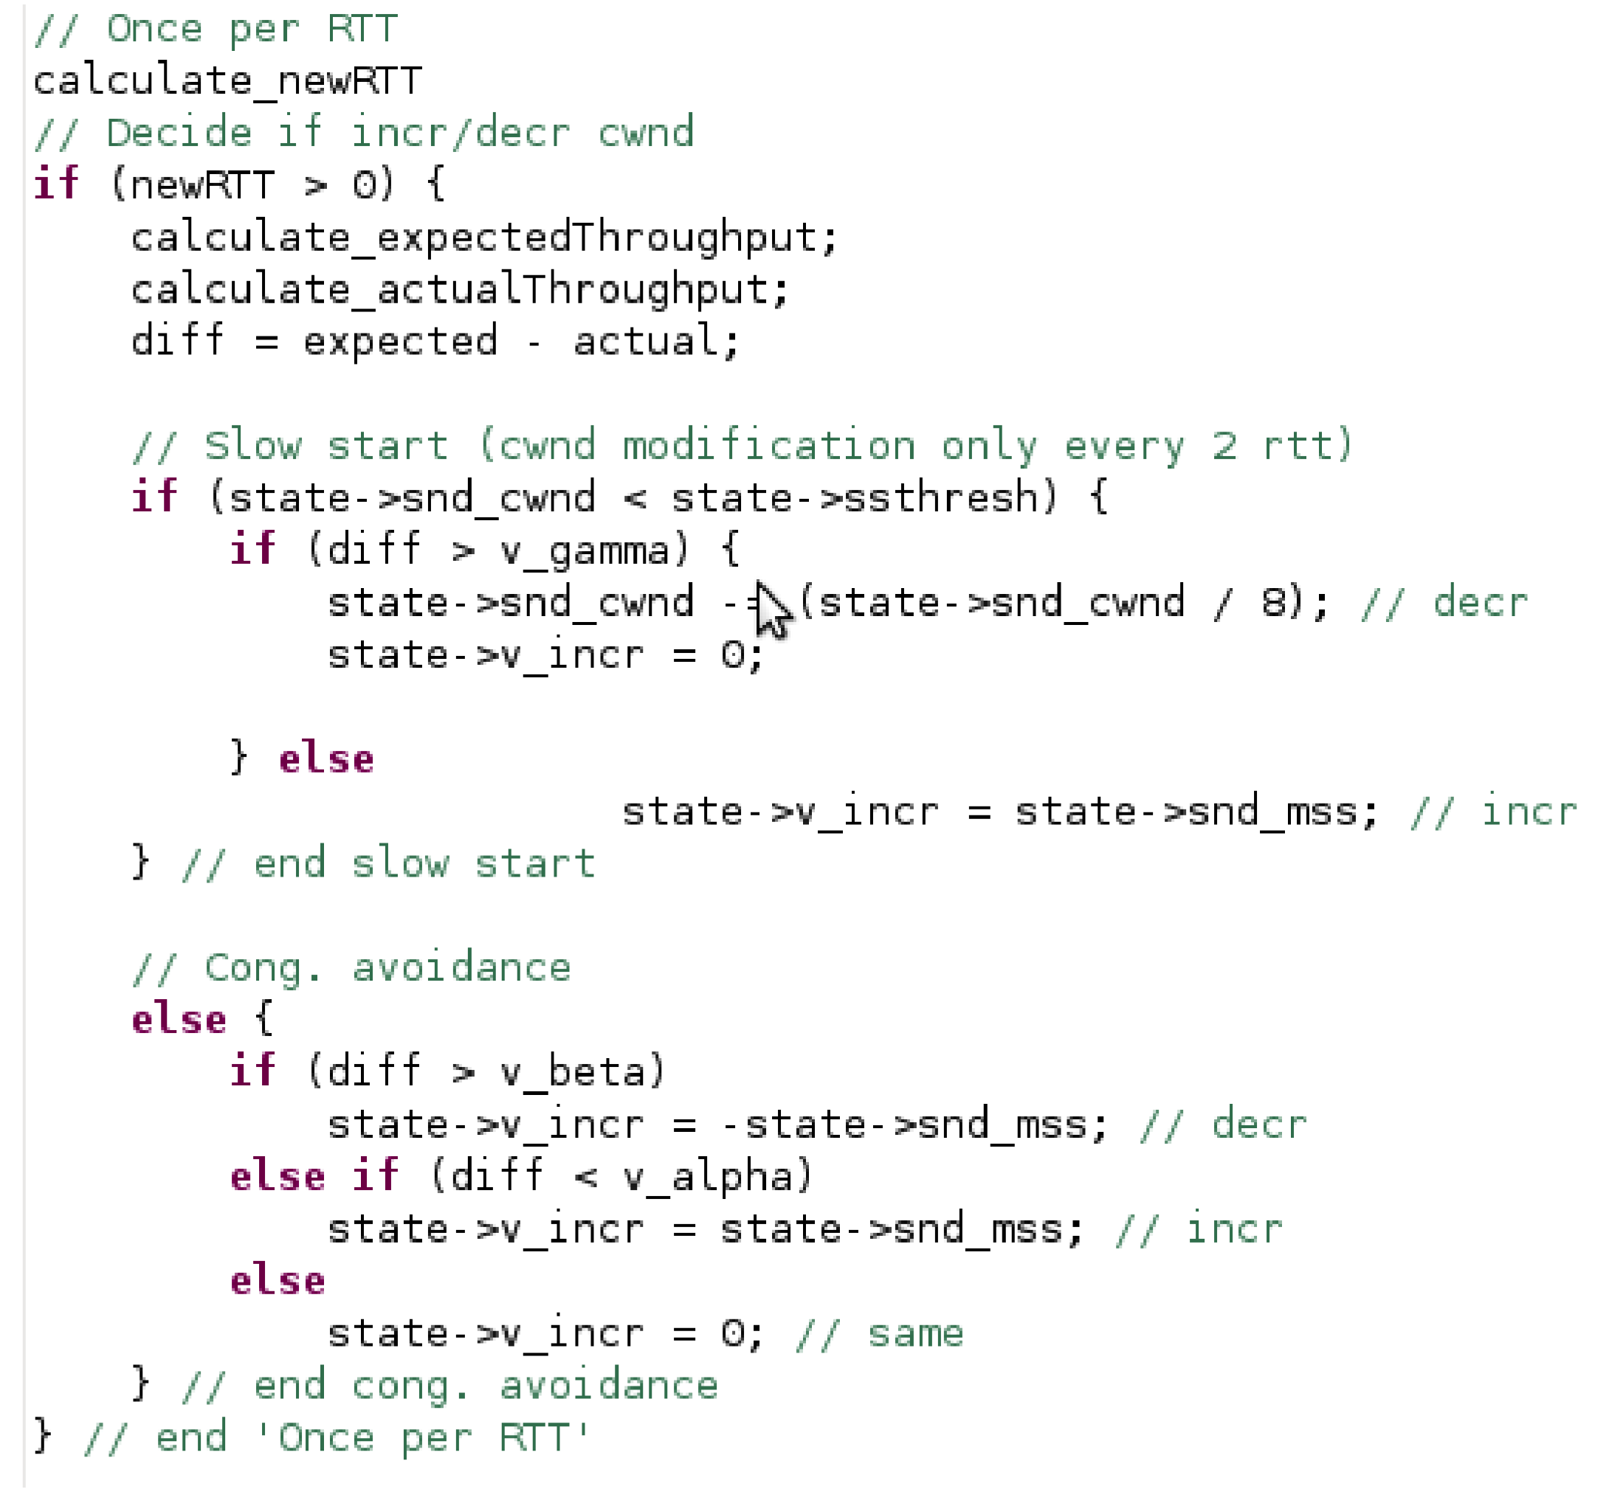
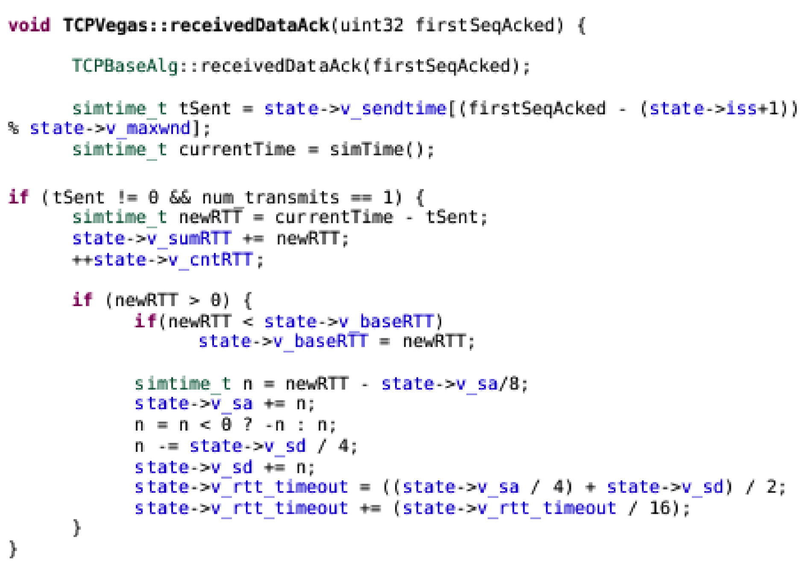
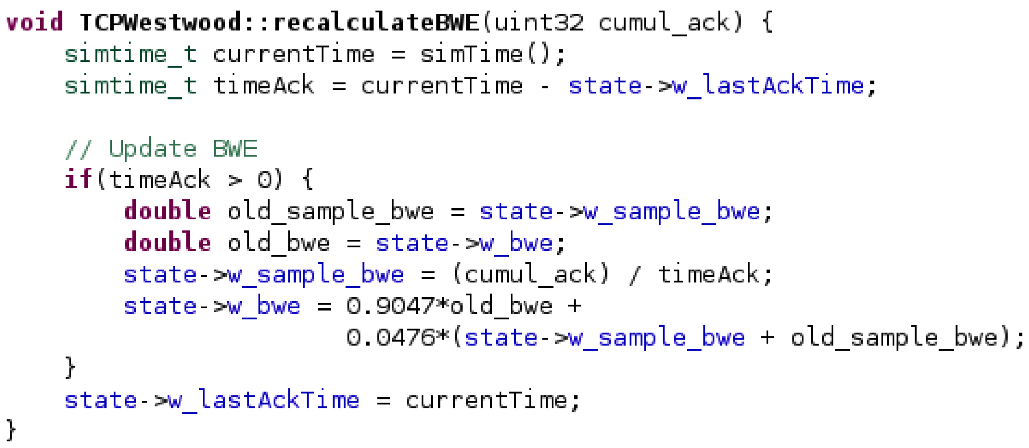
Implementation
TCP Vegas: cwnd management
TCP Vegas: RTT & timeout
TCP Westwood:
BW estimation

Slide 6


Simulation results
10 MiB file request
Evaluated scenario:
100 Mbit/s channel
Adjustable PER & Delay
client
server
(PER = 0.5%)
(Delay = 1ms)
Ideal
Original authors’ data:
  Vegas improves Reno by about 46%
  Westwood improves Reno by about 30%

Slide 7
Simulation results
Retransmission behavior
TCP Vegas reduces timeouts by retransmiting more data
TCP Westwood: Reno efficiency with less less timeouts

Slide 8
Conclusions & Future Work
CONCLUSIONS
The world is wireless!
BUT…
The standard TCP protocol often offers a reduced performance in wireless environments
  Differences between wired and wireless networks (loss prone)
Although many alternatives to TCP have been proposed, INET 2.0/OMNeT++ only includes standard TCP
FIRST STEP: We implemented TCP Vegas and TCP Westwood for INET 2.0
Experimental results show that:
  The performance levels achieved agree with previously published results
  Significant benefits are achieved for channels characterized by high losses or high delays (or both)
  There is still a great margin for improvement → several research works on the topic
FUTURE WORK
Develop new TCP variants for INET
Develop new protocols, comparing against the most effective solutions available

Slide 9
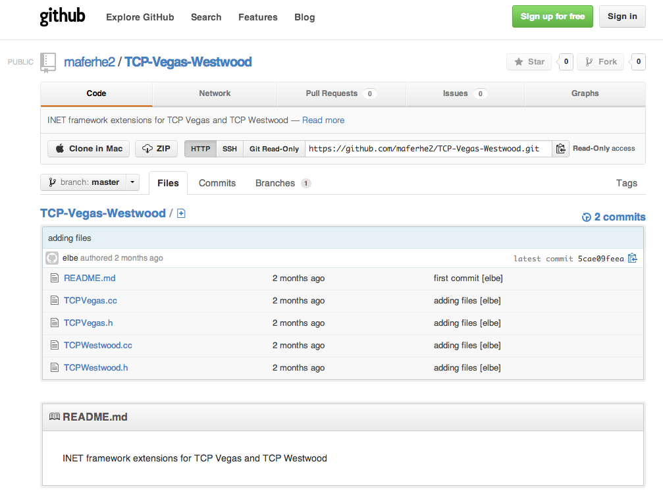
Available for download
https://github.com/maferhe2/TCP-Vegas-Westwood

Slide 10

Thanks!
Questions?

